Slide 1
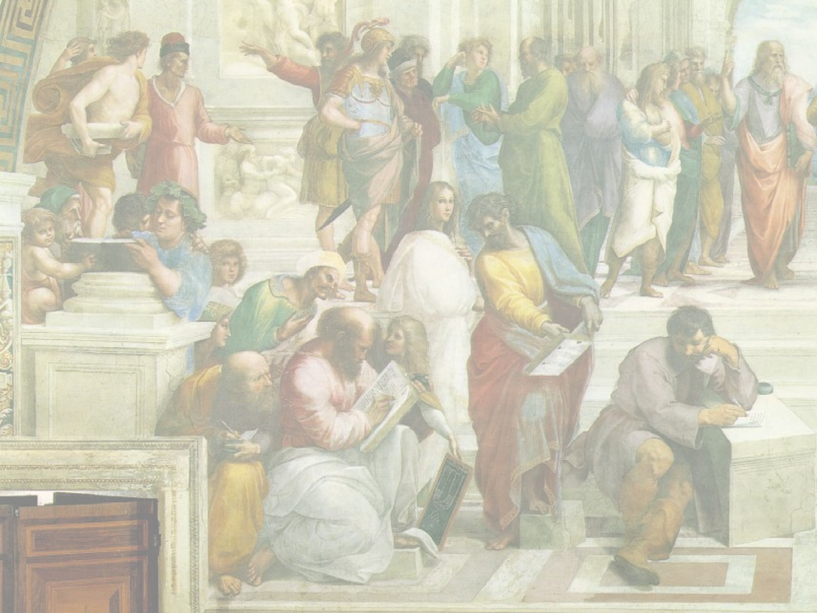
GEORGES LEMAITRE: The Fireworks Universe
Simon Mitton MA PhD FRAS FGS FRHistS
Life Fellow, St Edmund’s College, University of Cambridge
Website www.totalastronomy.com
Notes:
Title slide
1

Slide 2
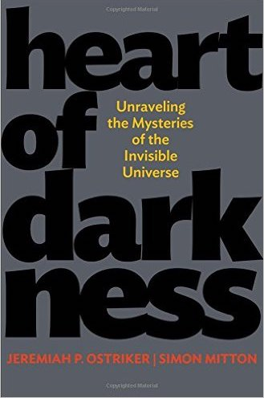
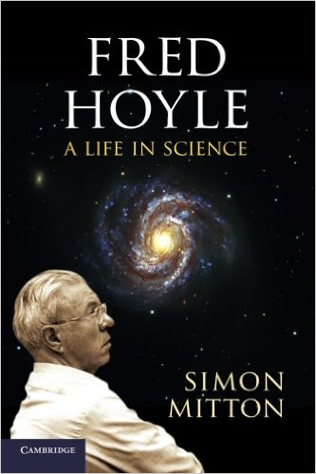
Astronomy and cosmology books by:
Simon Mitton MA PhD FRAS FGS FRHistS
Life Fellow, St Edmund’s College, University of Cambridge
Website www.totalastronomy.com
Heart of Darkness
JEREMIAH OSTRIKER & SIMON MITTON
Commended for PROSE Award 2013: Astronomy and Cosmology
Fred Hoyle: A life in science
SIMON MITTON
Notes:
Title slide
2

Slide 3

Goals of the Talk
To describe the discovery of the extragalactic universe, 1912 - 1933
To describe what Abbé Georges Lemaître proposed 85 years ago to explain these observations
To show how his abominable proposal became mainstream 1965 - 2015

Slide 4
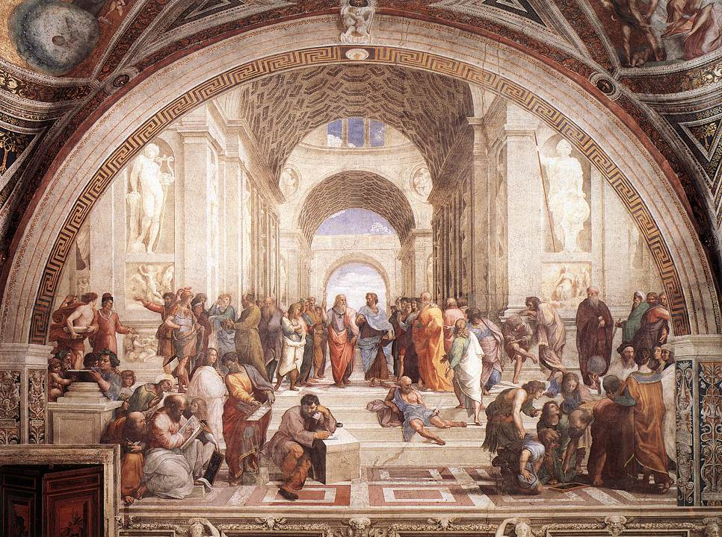
Notes:
4

Slide 5
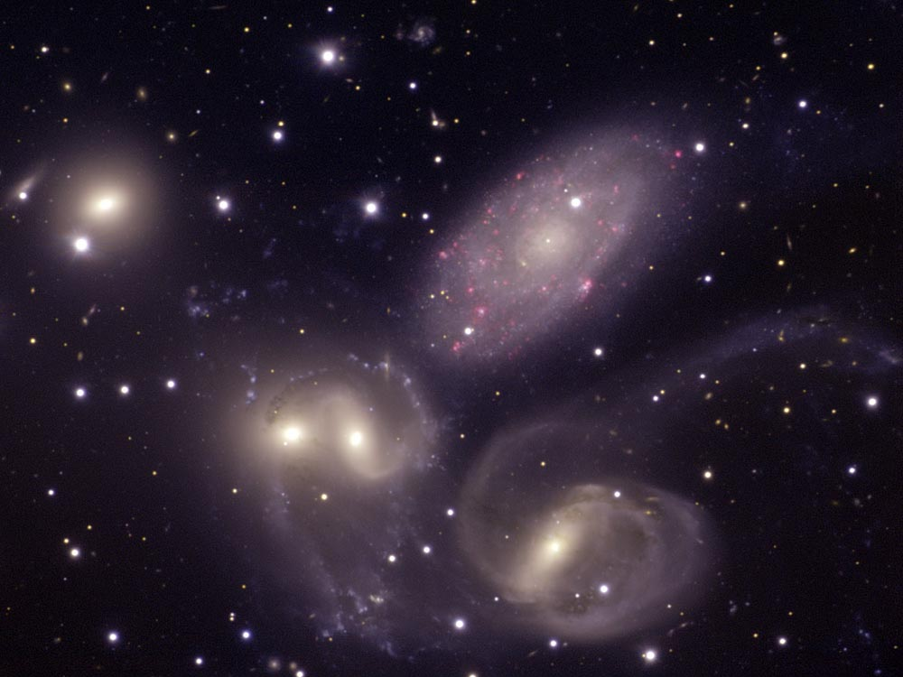
Cosmology: The Nature of the Universe
What kind of universe do we inhabit?
What is its history?
What was the Big Bang?
How did galaxies form?
How do we know what we know?
Notes:
Simon
Cosmology is less than a century old. It answers large and deep questions. This quest actually has a long history, beginning with Aristotle and Plato.
Jacqueline will now explain some of the astronomy that is used to explore the universe.

Slide 6
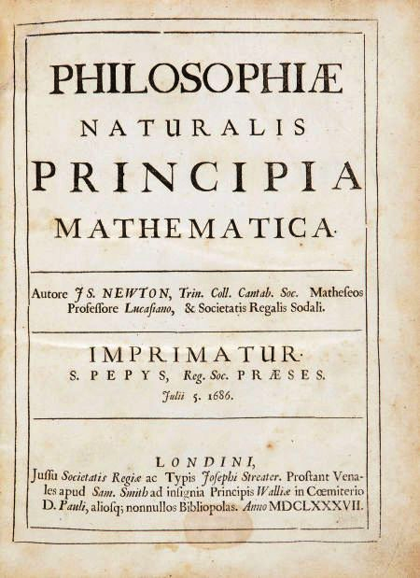
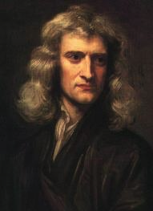
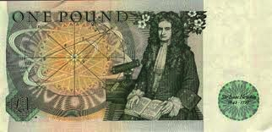
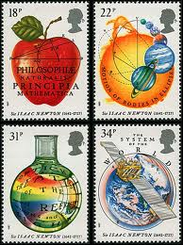
Newton’s Principia
Notes:
6

Slide 7
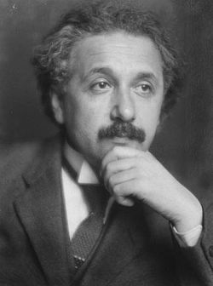
Einstein's Theory of General Relativity
In November 1915, Albert Einstein announced his General Theory of Relativity.
It replaced Newton’s clockwork universe. Einstein’s described gravity as a geometric property of space and time. This was a truly revolutionary idea about the universe.

Slide 8
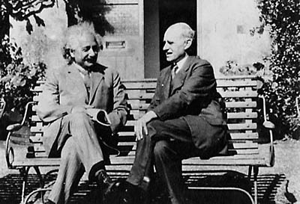
Total Eclipse of 1919
In 1915 Einstein published the General Theory of Relativity, a theory of gravity that includes the “time” dimension
Arthur Eddington in Cambridge understands that Einstein’s maths can be used to figure out the properties and behaviour of the entire universe. A few mathematicians in Europe toyed with Einstein’s equations.
At the Total Eclipse of the Sun in 1919 Eddington confirms Einstein’s theory, which thereafter is how mathematicians work out what’s what in the universe
Einstein and Eddington, The Observatories
Notes:
8

Slide 9
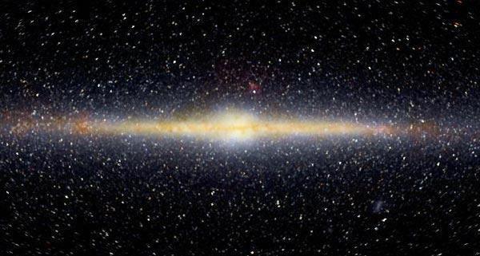
The Static Universe Model
One hundred years ago, astronomers thought:
The universe was unchanging through time.
The stars of our galaxy (the Milky Way) made up the whole universe
The galaxy was nearly motionless
Physicists trying to create a model for the universe had to match these "facts".
The challenge to these facts started in Cambridge as early as 1917

Slide 10
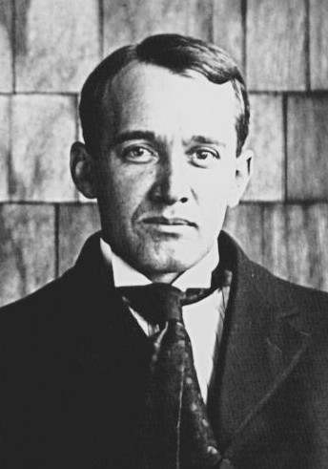
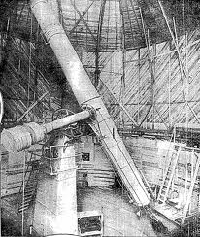
But the Universe is not static!
In 1912, far away in Arizona, a young astronomer had clocked the speed of a galaxy for the first time
By 1917 Vesto Slipher discovered that a dozen nearby galaxies are racing away from the Milky Way (redshifted)
What could this mean?
For certain it meant that galaxies were far beyond our own Milky Way Galaxy
Notes:
10
Expansion of Universe
Our story begins almost a century ago, in the railroad town of Flagstaff, in northern Arizona. In 1913 VS made the first attempt to measure the velocity of a galaxy wrt Milky Way. Extremely difficult. 1917 announces that a dozen gakaxies are distancing themselves from the MW. He had expected half to approach, half to recede.
What could this mean

Slide 11
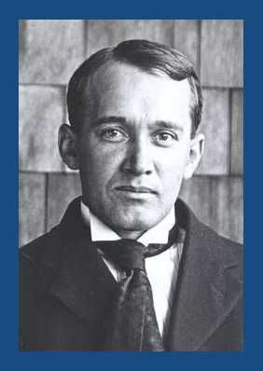
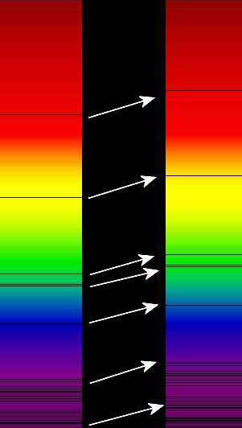
Discovery of Galactic Redshifts
In 1912, Vesto Slipher was the first to observe the shift of spectral lines of galaxies, making him the discoverer of galactic redshifts.
Redshifts are analogous to the Doppler effect – think racing cars or trains passing you at speed.
An observed redshift due to the Doppler effect occurs whenever a light source moves away from an observer.
Conversely, light sources moving towards an observer are blueshifted.

Slide 12
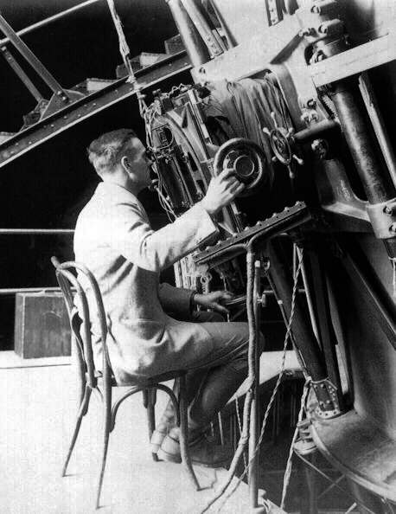
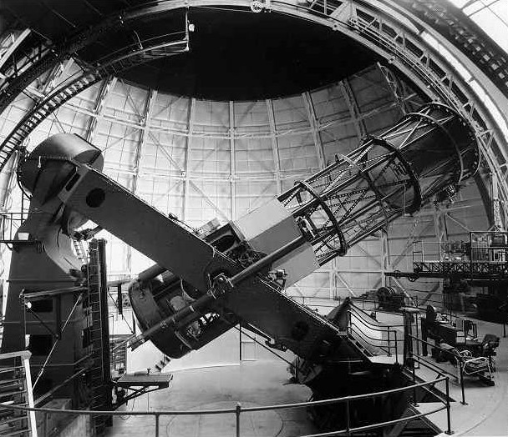
Hubble 1923: Distance of M31
The 100-inch telescope at Mount Wilson came into service in 1917
Edwin Hubble, aassisted by Milton Humason, began a serious observational attack on white nebulae
Hubble identified Cepheid variables in the Andromeda Nebula M31
In 1923 he announced the distance to M31. He had discovered the immensity of the extragalactic universe
Hubble and Humason then measured the distances to other nebulae for which Slipher had velocities

Slide 13
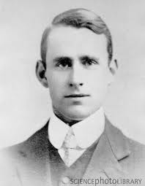
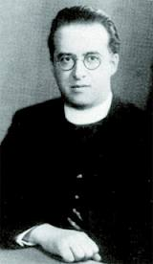
Lemaître in Cambridge 1923 - 24
Arthur Eddington, mathematician and astronomer at Cambridge, was considered the world expert on Einstein’s theory
Georges Lemaître, a Belgian priest with a doctorate in mathematics, travelled to Cambridge in October 1923 to work with Eddington on finding solutions to Einstein’s equations. Their aim was to find what properties of the universe were allowed by Einstein.

Slide 14
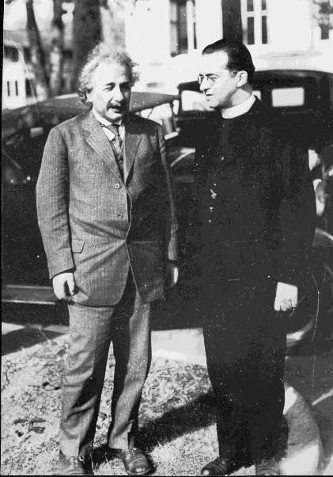
1924 Lemaître in America
1923-24. Georges Lemaître and Arthur Eddington in Cambridge work together on Einstein’s models of the universe
1924 Lemaître the theorist goes to the other Cambridge (Boston, USA) to work at Harvard and MIT. He meets astronomers who use large telescopes to view the distant universe: Vesto Slipher and also Edwin Hubble, with both of whom he discusses model universes
Notes:
14

Slide 15
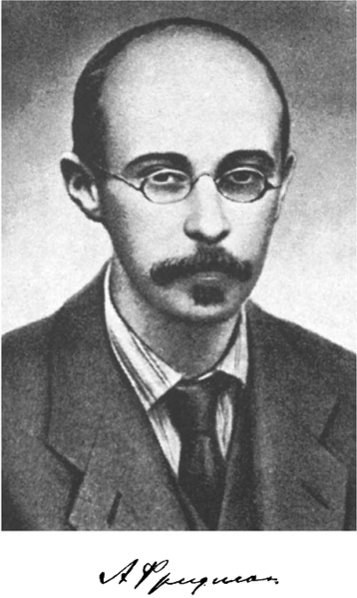
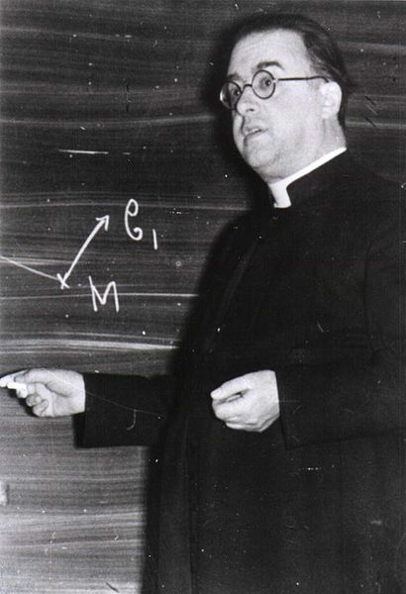
The Fate of the Universe
There are many possible answers to Einstein's equations. Each solution implies a possible ultimate fate of the universe.
Alexander Friedman in Russia proposed a number of such solutions in 1922, as did Georges Lemaître in Belgium in 1927.
Both of them published in obscure journals (a mistake!). The remarkable fact about their answer was this:
The Universe is Expanding (a big shock!)

Slide 16
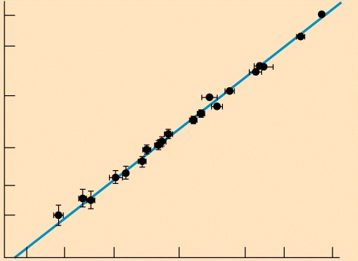
A truly amazing discovery:
The universe is expanding
Speed away from us
Distance from us
Notes:
A few years later. Hubble law low redshift. With more data, astronomers accepted that the universe is expanding, our first great discovery. From the Hubble diagram it is possible to assign an age to the universe, 13.7 Gyr

Slide 17
Lemaître 1927-1931
1927 Lemaître has an explanation for Hubble’s results.
Publishes in 1927 a paper on the expansion of the universe in which he demonstrates that the model is consistent Einstein’s maths
Einstein regards this as “preposterous” but Eddington supports his former student, and promotes his preposterous theory!
1930 Lemaître speaks on the expanding universe at the Royal Astronomical Society.
Lemaître called his model the “Fireworks Universe”. The expression “Big Bang” came later, in 1948, courtesy of Fred Hoyle.
Notes:
17

Slide 18
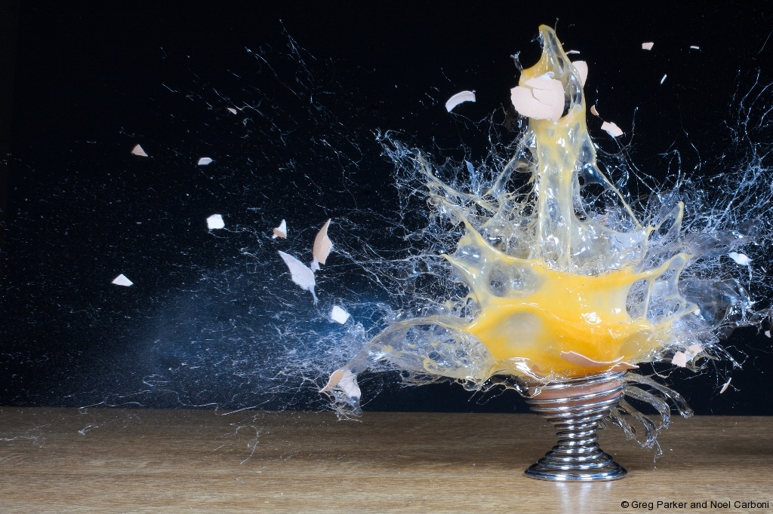
A Primeval "Cosmic Egg"?
In 1931, Georges Lemaître published a model of the universe suggesting that the expansion of the universe might have originated when a primeval "cosmic egg" exploded in spectacular fireworks, creating an expanding universe.
Published as a brief letter in the journal Nature, it wasn't taken seriously at the time. But now, his contribution is highly valued.

Slide 19
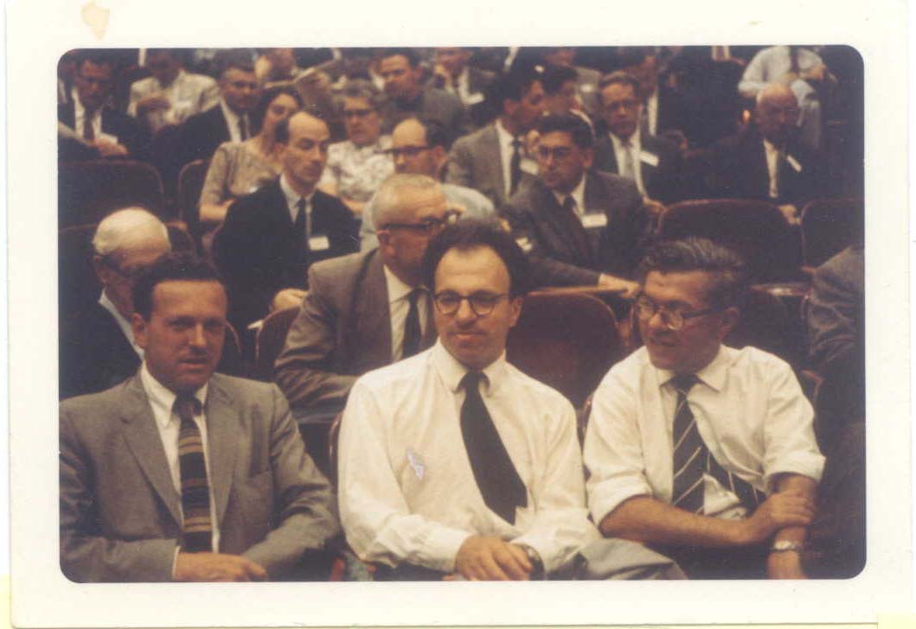
Cosmology… …in a cinema!
In World War II these three mathematicians researched naval radar for the Admiralty (British Navy)
When they returned to Cambridge University in 1946 they worked on theoretical astronomy
They went to the cinema once a week. They saw a movie Dead of Night in which the main action centres on several recurrent nightmares.
Gold (on the left of this 1960s photograph) joked “What if the Universe is like that?
This led to the concept of a Steady State Universe, a notion that the three of them enthusiastically promoted.
Astronomers had to decide:
Big Bang (sudden start) promoted by Lemaître, or,
Steady State (has existed for ever) promoted by Cambridge mathematicians
Gold, Bondi, and Hoyle
Rome IAU 1952

Slide 20

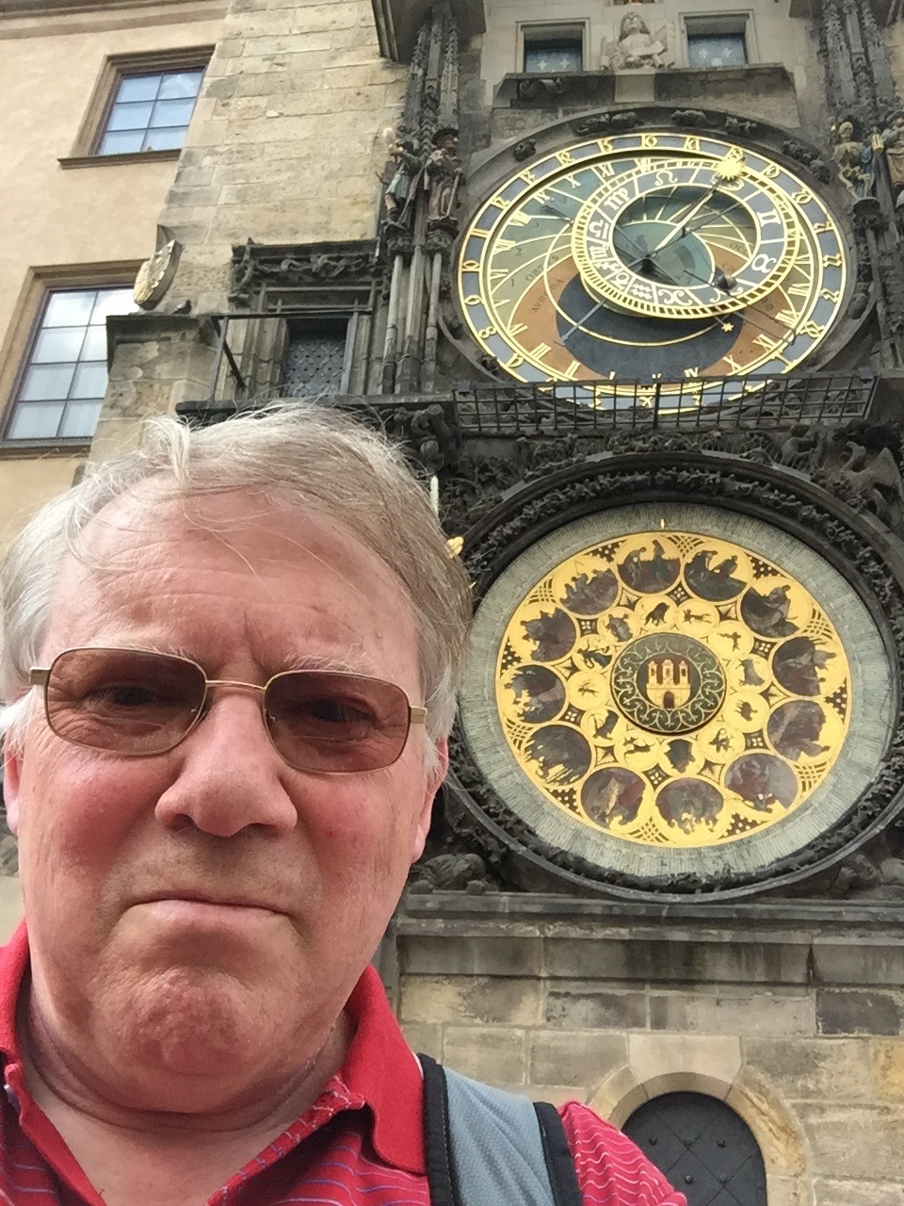
Learn more by reading this book
Notes:
20

Slide 21
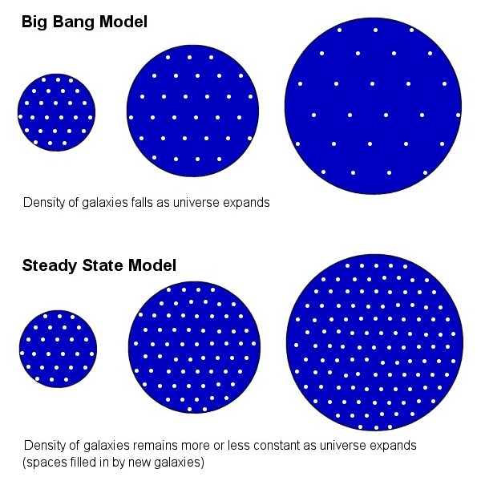
“Big Bang” or Steady State?
There were two primary explanations put forth for the expansion of the universe:
Lemaître's “Big Bang” theory, advocated and developed by George Gamow.
A Steady State model, proposed in 1948 by Hermann Bondi, Thomas Gold, and Fred Hoyle, in which new matter would be created as the galaxies moved away from each other. In this model, the universe is roughly the same at any point in time.

Slide 22
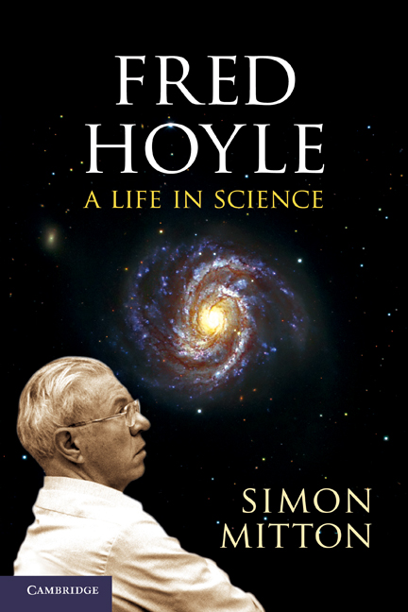
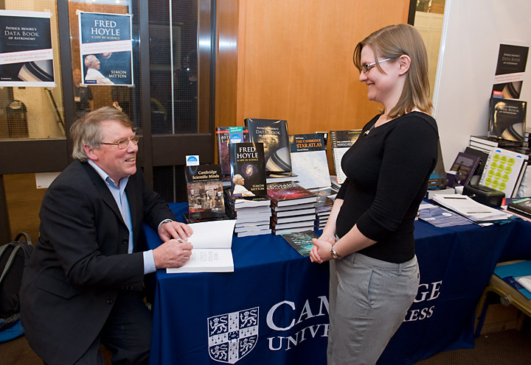
Learn more by reading this book
Notes:
22

Slide 23
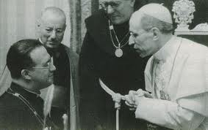
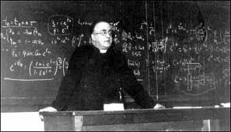
Lemaître and Pius XII
Pius XII, found Lemaître’s Fireworks Universe attractive. The Big Bang allowed that the universe exploded into existence with a burst of light. He said that the apparent order in the universe was a sign of divine reation
Georges Lemaître was shocked in 1952 when Pius XII was to speak at the General Assembly of the International Astronomical Union in Rome on creation and the Big Bang. Lemaître interrupted a trip to South Africa in order to visit the Vatican and advise the Holy Father against connecting Divine Creation with the Big Bang. This echoed Aquinas who taught that theology and natural philosophy are two roads to the truth

Slide 24
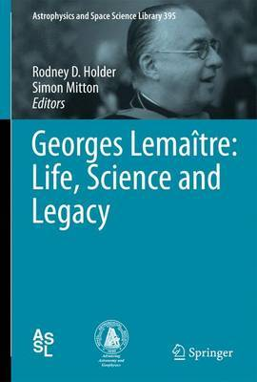
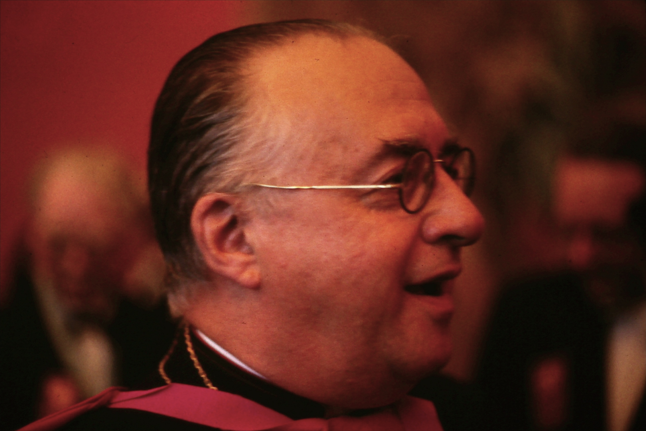
Learn more by reading this book
Notes:
24

Slide 25
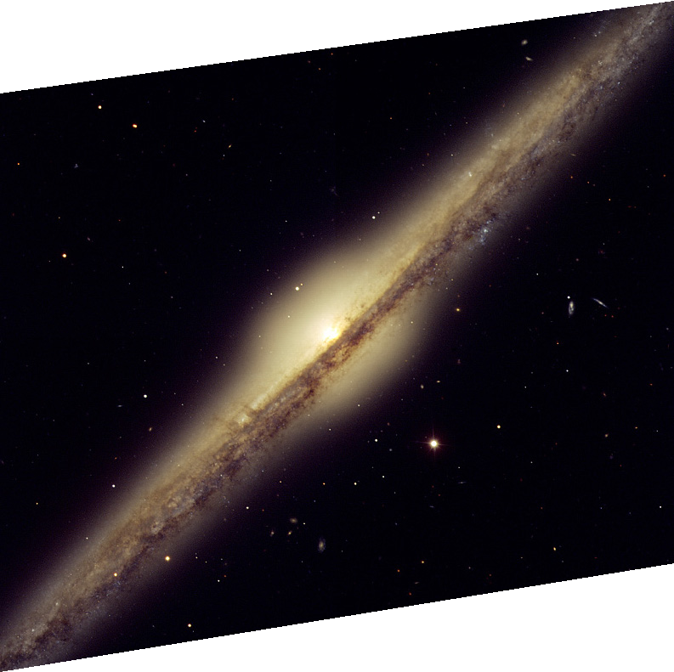
Looking through Space and Time
A light year – the distance light travels in one year
(10,000,000,000,000 km)
Galaxy 50 million light years away
It looked like this 50 million years ago
A telescope is a time machine!
Notes:
Jacqueline
The universe is enormous. Explain light year (ten trillion kilometres). Explain concept that more distant objects are seen at earlier times. Mention that light from the most distant galaxies has taken more than ten billion light years to reach us.

Slide 26
Finding the Big Bang
In the Steady State version the universe never changes its appearance: The far away universe looks more or less the same as the local universe
In the Big Bang version the universe changes its appearance over time. The distant universe is younger than the nearby universe …
By the mid-1950s there was good evidence that the universe has evolved. Lemaître’s concept slowly gained ground
In 1964 there was fundamental breakthrough …

Slide 27
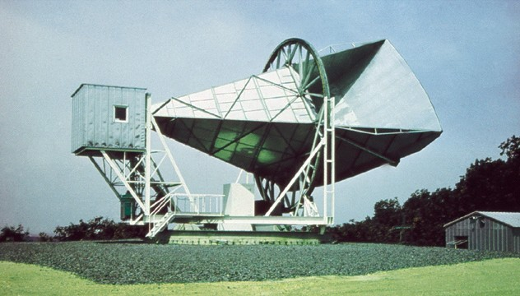
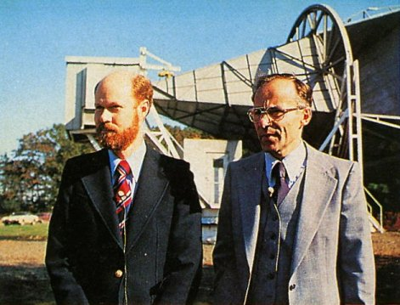
The proof in favour of the Big Bang
the whole universe is filled with radio waves
1964. This strange radio antenna accidentally discovered that the entire sky emits a weak microwave signal
The microwaves are a form of radiant heat at a very low temperature
What had been discovered was heat energy, in the form of microwaves, released by the Hot Big Bang
Arno Penzias and Bob Wilson
1978 Nobel Prize Physics
Notes:
Second discovery
Telescope Holmdell, New Jersey, about 20 miles from NYC
Penzias and Wilson noticed that the telescope always picked up a faint signal, no matter what. [Time step]
They eliminated all local sources. [Time step]
When they told colleagues of their strange discovery, one at Princeton University realised immediately that they had discovered the heat radiation released in the Big Bang, now weak and dilute
Confirmed Hot Big Bang

Slide 28
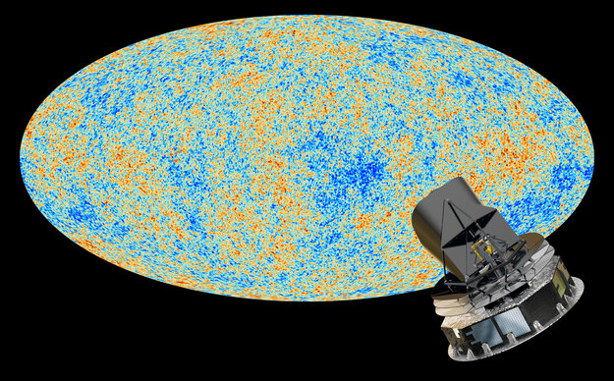
The Cosmic Microwave Background
1964-65 An accidental discovery – the universe is filled with microwaves
2013 European Space Agency Planck Mission: the most precise all-sky map of the oldest light in the universe
Notes:
Planck March 2013
Three years ago the European Space Agency launched an even better microwave probe, named Planck. And a few weeks ago astronomers were enthralled with the all-sky image you see here. This is the most precise map ever made of the oldest light in the universe, emitted just 380,000 years after the start of the Big Bang. The grainy structure here took 15 months to analyse in order to measure just six numbers that specify the properties of our universe. One of those numbers is the Age of the Universe, which came out at 13.82 billion years, a hundred million years older than previously thought. The map also has solid evidence about dark matter and exotic dark energy.

Slide 29
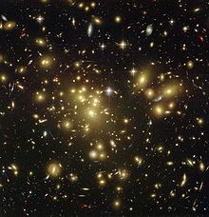
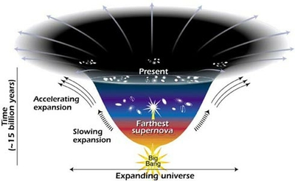
Dark Matter & Dark Energy
Over the past 35 years or so, cosmologists’ and physicists' understanding of the universe has been turned on its head.
It is now generally accepted in the scientific community that ‘normal matter’ — the matter that we experience in our everyday lives, and that scientists have been studying since the time of the ancient Greeks — comprises only about 4% of the matter in the universe.
So, what is the other 96%?

Slide 30
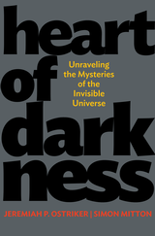
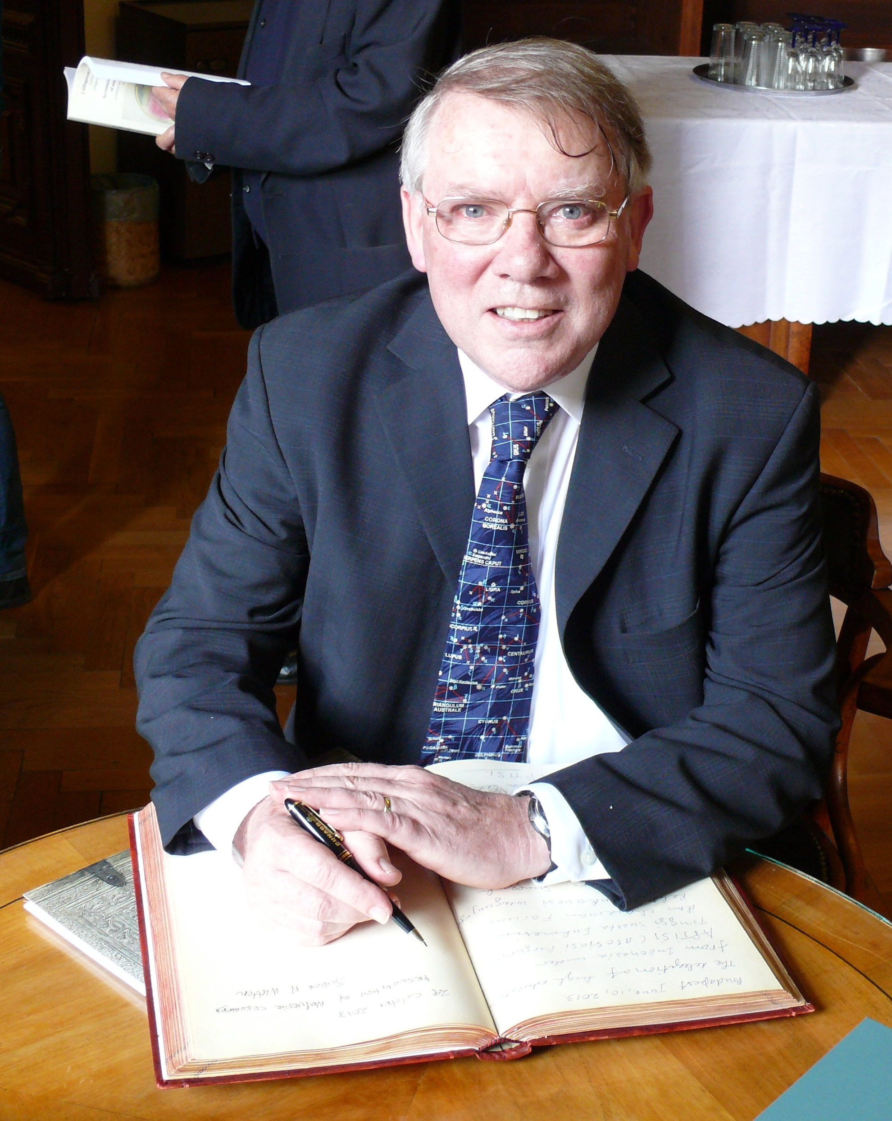

Learn more by reading this book
Notes:
30

Slide 31
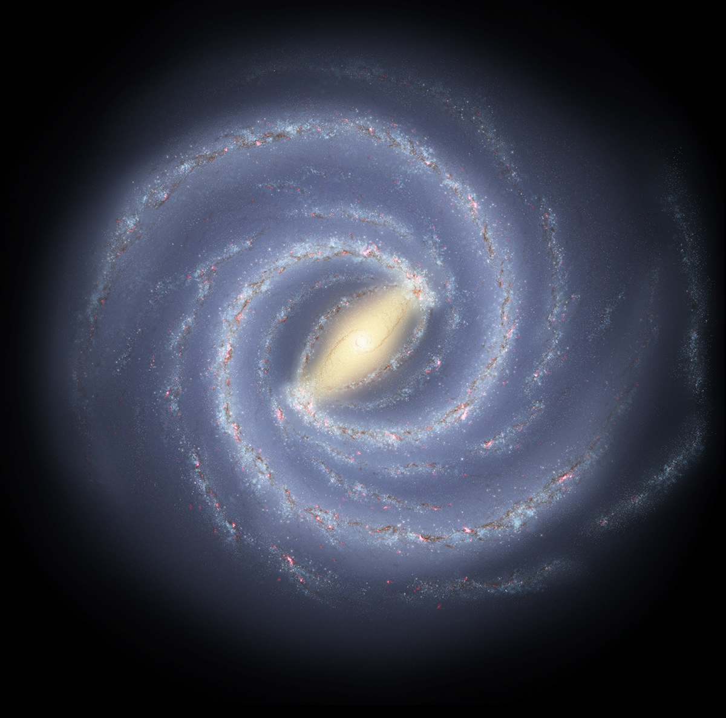
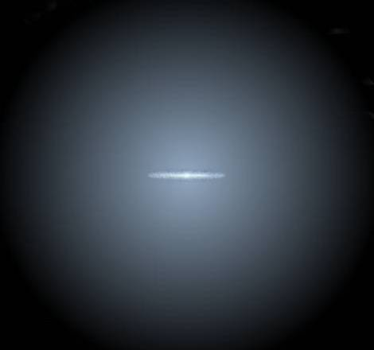
100,000 light years
Dark matter halo
Solar system
Disc of the Galaxy

Slide 32
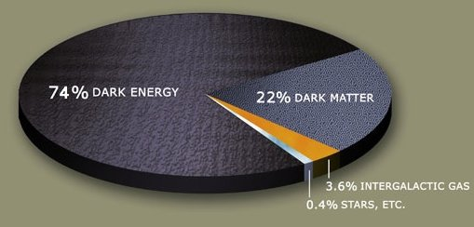
Dark Energy
Evidence for Dark Matter and Dark Energy has accumulated, and it is now estimated that only about 4% of the matter/energy in the universe is 'ordinary matter'.
In other words, we have no real clue what the other 96% consists of!
This is most embarrassing!

Slide 33
Dark Energy and Lemaître
Lemaître’s concept is now central to our present understanding of the universe
The expansion is propelled by dark energy
The dark energy is a fundamental property of the universe
Lemaître is now referred to as “The father of the Big Bang”

Slide 34
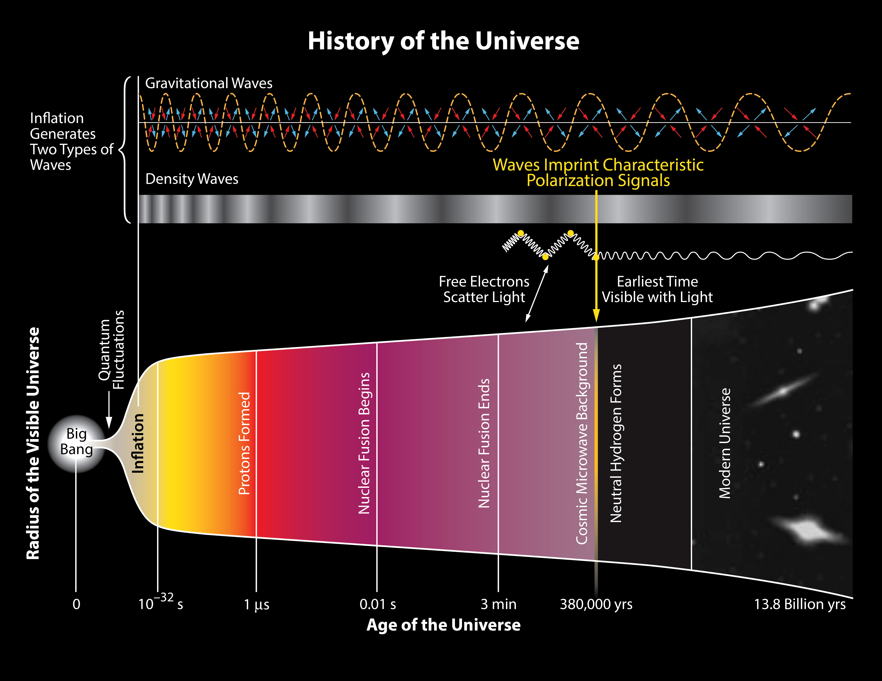

Slide 35
Astronomy and cosmology books by:
Simon Mitton MA PhD FRAS FGS FRHistS
Life Fellow, St Edmund’s College, University of Cambridge
Website www.totalastronomy.com
Heart of Darkness
JEREMIAH OSTRIKER & SIMON MITTON
Commended for PROSE Award 2013: Astronomy and Cosmology
Fred Hoyle: A life in science
SIMON MITTON
Notes:
Title slide
35

